Slide 1
XML
Extensible Markup Language

Slide 2
What is XML?
An infrastructure for describing text and data
Developed by W3C(the World Wide Web Consortium) http://www.w3.org/
An XML document contains special instructions called tags
XML allows users to define their own tags

Slide 3
What is XML?
A language for describing data of any type
A language for creating other markup languages
  A metalanguage
Derived from SGML(Standard Generalised Markup Language)
  XML subset of SGML

Slide 4
Comparison with HTML
HTML is a markup language for displaying information(with elements like headings and paragraphs, bold and italics), XML is a markup language for describing data, that is for managing information
HTML has a fixed collection of tags, XML allows users define their own tags

Slide 5
XML
With XML any type of information can be represented by creating a new markup language
  Music
  Recipes
  Molecular structure of chemicals
  Mathematical formulae

Slide 6
XML – new tags
Consider a database of books. In XML you could have tags to represent:
  Booktitle
  Author
  Price
  ISBN
  Etc…

Slide 7
XML example
<?xml version = “1.0”?>
<!-- A first XML Example-->
<book>
<booktitle>The XML Companion</booktitle>
<author>Neil Bradley</author>
<price>$99.00</price>
<ISBN>0201674866</ISBN>
</book>

Slide 8
XML example
<?xml version = “1.0”?>
<!– Format of a newspaper artice-->
<article>
<title>XML in Action</title>
<date>April 2, 2007</date>
<author>
<fname>Joe</fname>
<lname>Bloggs</lname>
</author>
<summary>Example of XML</summary>
<content>XML is a Markup Language that allows its users to specify their own tags</content>
</article>

Slide 9
Strengths of XML
It is a simultaneously human and machine readable format
It supports Unicode, allowing information written in any human language to be communicated
It can represent data structures in computer science such as records, lists and trees
Its self-documenting format describes field names as well as values
The strict syntax makes parsing algorithms simple
It is platform independent

Slide 10
Criticisms of XML
Its syntax is verbose
This may effect efficiency of applications using XML
Does not directly support data types

Slide 11
Another example
<?xml version="1.0" encoding="UTF-8"?>
<recipe name="bread" prep_time="5 mins" cook_time="3 hours">
<title>Basic bread</title>
<ingredient amount="3" unit="cups">Flour</ingredient>
<ingredient amount="0.25“ unit="ounce"> Yeast</ingredient>
<ingredient amount="1.5" unit="cups“ state="warm">Water</ingredient>
<ingredient amount="1" unit="teaspoon"> Salt</ingredient>
<instructions>
<step>Mix all ingredients together, and knead thoroughly.</step>
<step>Cover with a cloth, and leave for one hour in warm room.</step>
<step>Knead again, place in a tin, and then bake in the oven.</step>
</instructions>
</recipe>

Slide 12
XML Syntax
XML Declaration
<?xml version="1.0" encoding="UTF-8"?>
Elements
<step>Mix all ingredients together, and knead thoroughly.</step>
Attributes
<ingredient amount="3" unit="cups">Flour</ingredient>
Document Element- every xml document should have one of these: in previous example this is the recipe element(root element)

Slide 13
XML Syntax
Empty Elements
  Special syntax is provided for these elements
    <emptyelt/>
    Normally an element would be denoted by
    <emptyelt></emptyelt>
Special Characters: e.g. if you need to use < or > as actual text..five predeclared entities
  &amp &
  &lt <
  &gt >
  &apos ‘
  &quot “
  e.g to produce: M&E Enterprises in an XML browser <company-name>M&amp;E Enterprises</company-name>

Slide 14
Correctness in an XML document
Two measures of correctness exist
  Well-formed: does the xml file conform to all syntax rules, e.g. does a non-empty element have a closing tag as well as an opening tag
  Valid: the data conforms to a set of user defined rules. These rules are specified in the Document Type Definition(DTD).

Slide 15
Well-formed XML documents
Well-formed documents have the following properties:
  One and only one root element
  Non-empty elements are delimited by a start-tag and an end-tag
  All attribute values are quoted
  Tags may be nested but must not overlap
  Element names are case sensitive

Slide 16
Valid XML documents
A Valid XML document must be
  Well-formed
  Must comply with a description of the type of the XML document
Prior to the arrival of XML if two programs needed to share information the software designers had to define special file formats to share data. This required writing detailed specifications of these formats and special-purpose parsers

Slide 17
Customized Markup Languages
MathML
  Developed for describing mathematical notation
  Comparison with Latex
    Latex uses special symbols which may not be intuitive
    MathML more meaningful, can be displayed on the web

Slide 18
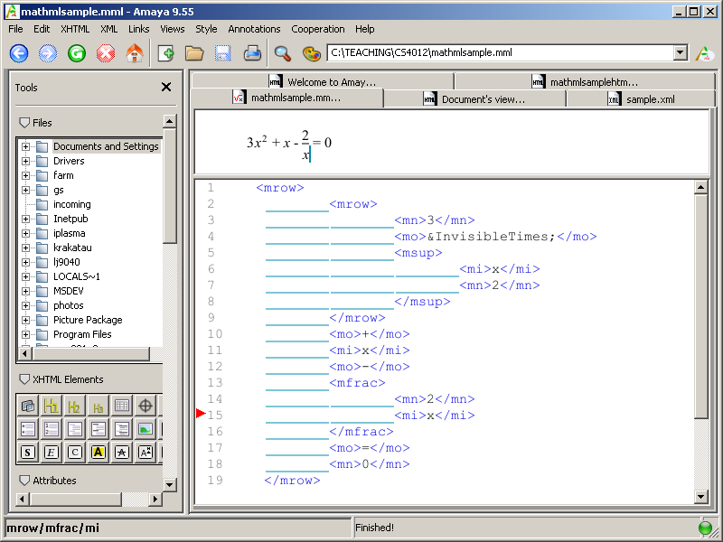
MathML example

Slide 19
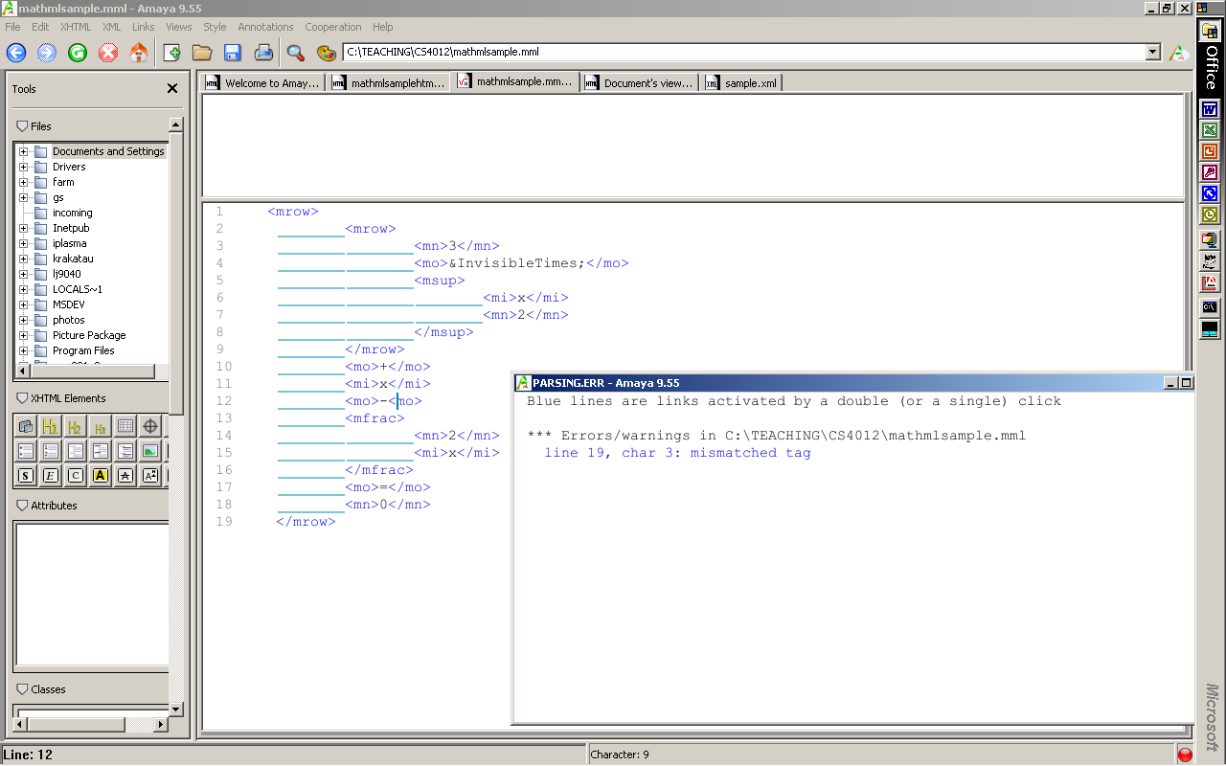
Errors in XML

Slide 20
XML and Web editing tool
Amaya
  http://www.w3.org/Amaya/Overview.html
  Download and install

Slide 21
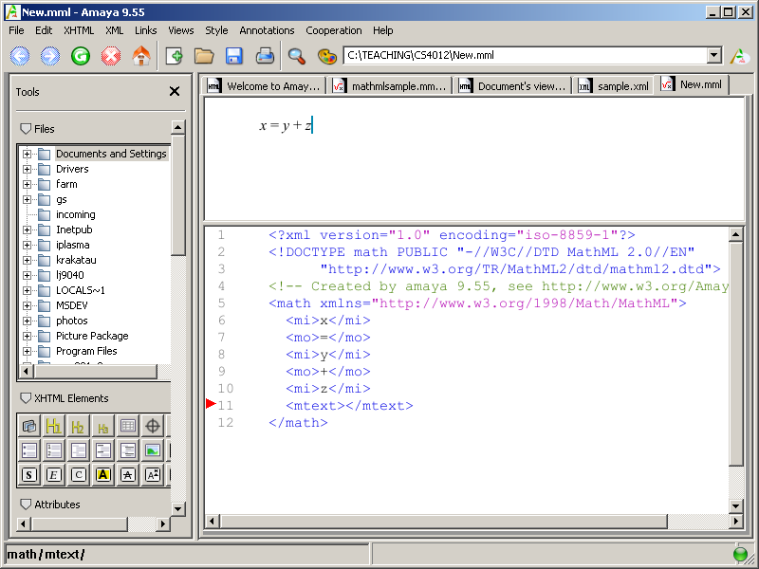
Amaya
You can use Amaya to produce MathML

